Slide 1
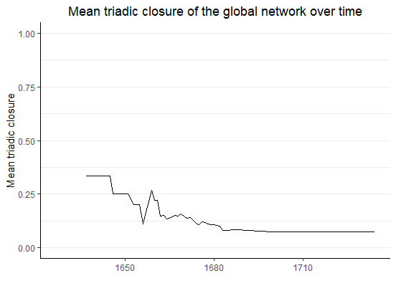
The network exhibits low triadic closure over time
Complex network with low interconnectivity
May suffer from instability when negative relationships occur
Potential for structural gaps and natural development of many new connections

Slide 2
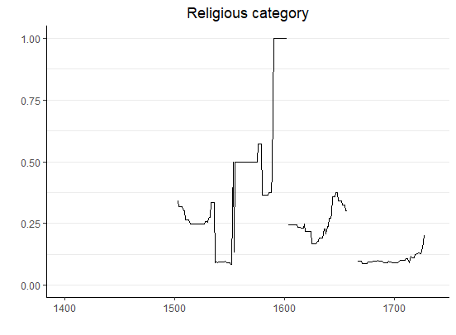
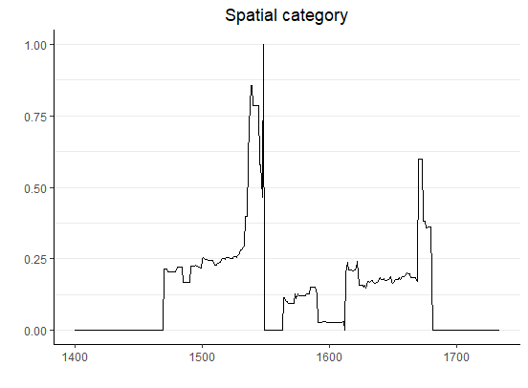
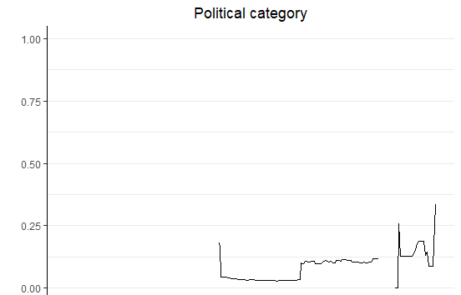
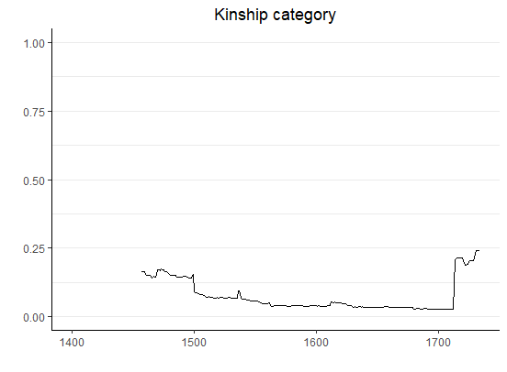
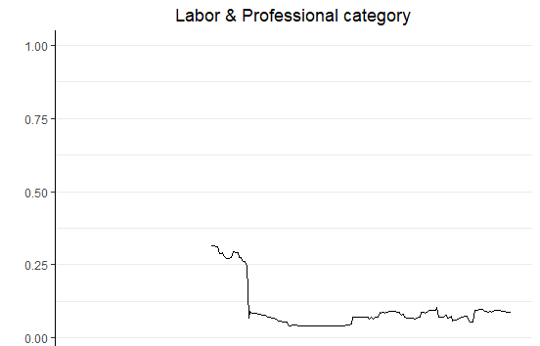
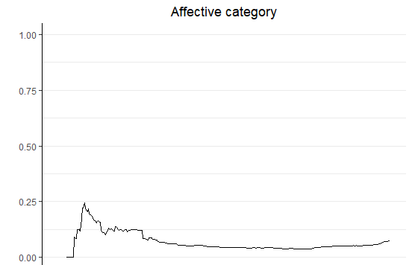
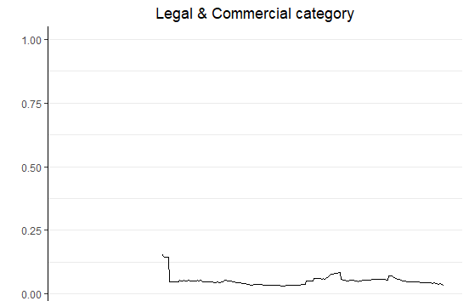
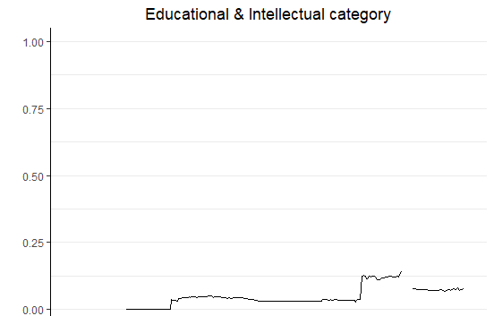
Mean triadic closure varies based on the type of relationship between people
8 sub-networks of all members with a certain connection type and their 1st degree connections
Mean closure
Mean closure

Slide 3
Expectedly high closure levels of religious and special connections
Mean closure
Mean closure

Slide 4
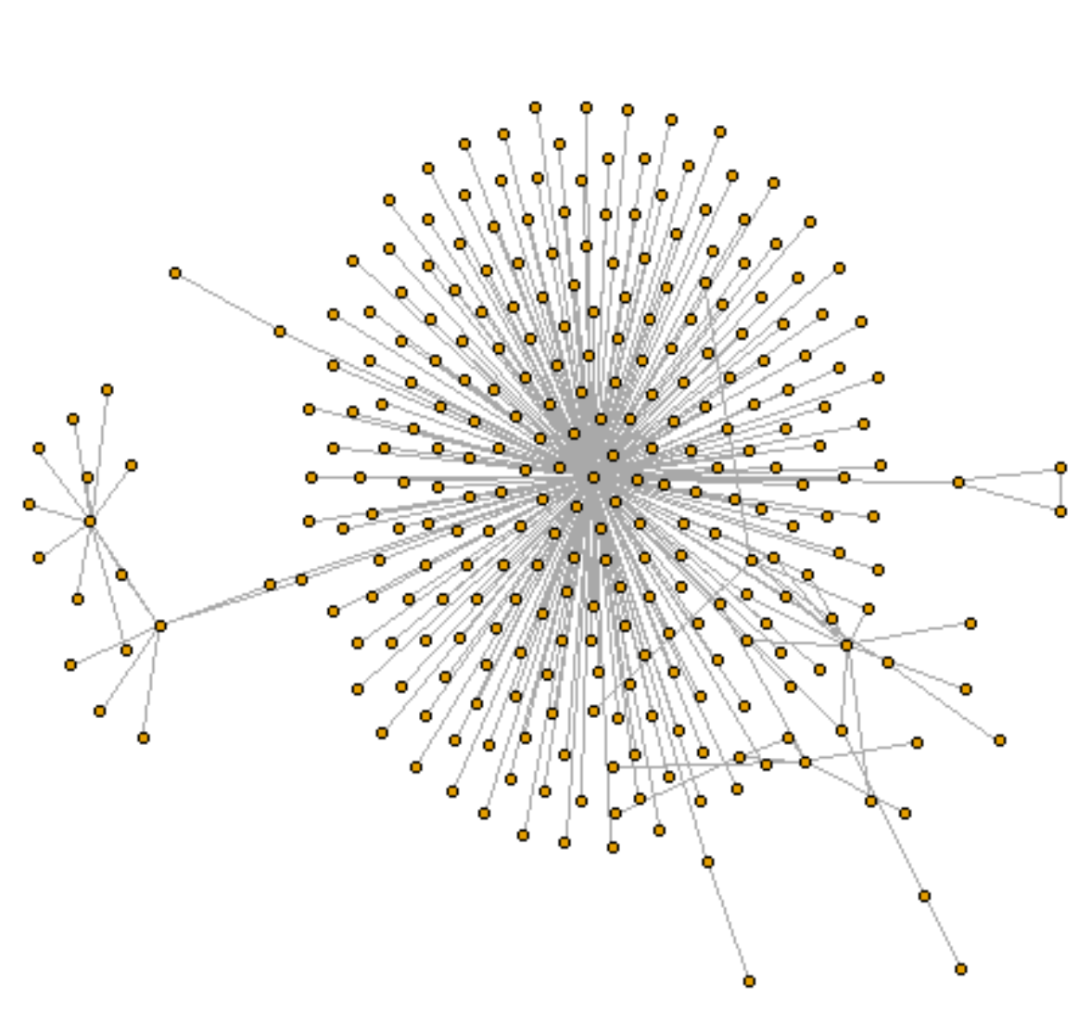
Unexpectedly low closure level of kinship connections
Friends of friends never introduced?
1st decree connections not historically important?
Closure within the category?
Mean closure

